Slide 1
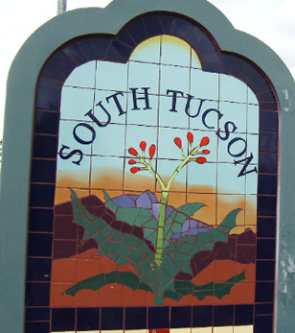
The City of South Tucson
1.2 square miles
5,730 population (1,900 families)
51% living below poverty level
Median income $22,867
28.8% homeownership rate
Median value owned homes=$75,900
339 business firms
47.8% Latino/a owned

Slide 2
How long have you lived in the City of South Tucson? 2013 (N=228)
Over 6 Years
Less than 5 Years
64%
36%

Slide 3
Would you recommend the City of South Tucson as a place to live?
Definitely!
53%
Definitely!
Probably
40%
40%
Probably
30%
2011 (N= 266)
2013
(N= 228)

Slide 4
Is it safe for kids in South Tucson?
(N=228)
81%
84%
91%
felt that children and youth were either safe or somewhat safe playing outside
felt that children and youth were either safe or somewhat safe going to and from school
felt that children and youth were either safe or somewhat safe during the school day

Slide 5
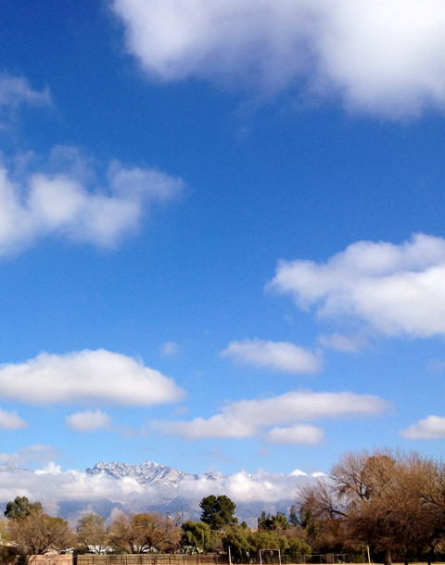

Do you feel safe in your community?
95%
86%
of people surveyed felt either very safe or somewhat safe
in their home during the day
of people surveyed felt either very safe or somewhat safe
in their home during the night
93%
60%
of people surveyed felt either very safe or somewhat safe walking during the day
of people surveyed felt either very safe or somewhat safe walking during the night

Slide 6
How often did you participate in the community in the last year? (N= 228)
Personally took action to improve the community
Community, resident
or tenant association
Volunteered to help others in the community
Participated in an
advocacy group
Supported a local political organization
Participated in
a community improvement project
Participated in an organized community social event
Supported local business events

